Slide 1
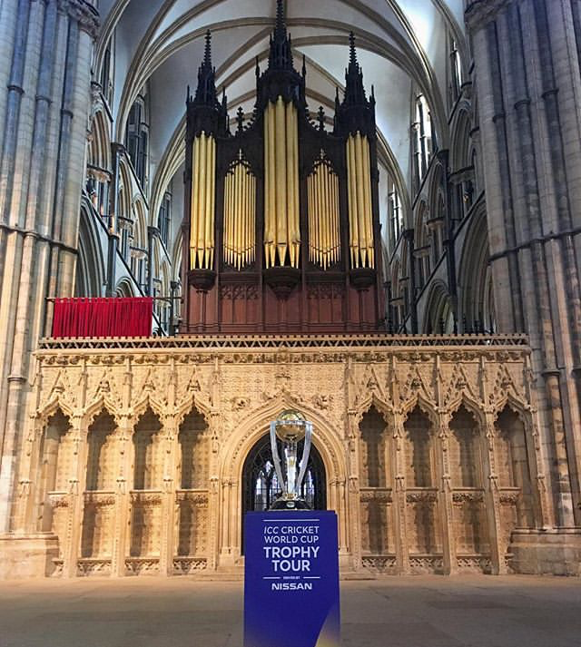
3 x All Star Cricket ‘Have-A-Go’ Taster Sessions / CWC Parties
1 - Friday 2nd Aug @ Sleaford Cricket Club
2 - Mon 19th Aug @ Skegness Central Beach
3 - Thur 22nd Aug @ People’s Park , Grimsby
2 FREE All- Star Cricket Taster Sessions will be run at each party!
Sign Up Here: https://ecb.clubspark.uk/haveago
10:00 – 10:15: Registration for the 1st session
10:15 – 11:30: 1st Session
11:30 – 12:00: All Star Kit handed out (1)
12:00 – 12:30: BBQ / Lunch / Picnics for all
12:30 – 12:45: Registration for the 2nd session
12:45 – 14:00: 2nd Session
14:00 – 14:30: All Star Kit handed out (2)
FREE!
Keeping Kids Active!
Developing their Movement & Coordination skills
Kids Enjoying Cricket! Aimed at 4-7 Yr Olds

