Slide 1
A story on going back to school after lockdown

Slide 2
We started the school year in our classroom.
Because of covid-19 we have spent some time at home, to try and stop the spread of the virus.
We have been learning at home and trying different activities.

Slide 3
The government have recommended that some children can now come back to school.
This means some children will be going back but their brothers or sisters may be staying at home.

Slide 4
This is so that there are not too many people there.
Some things in school will be different.
Some things will be the same.

Slide 5
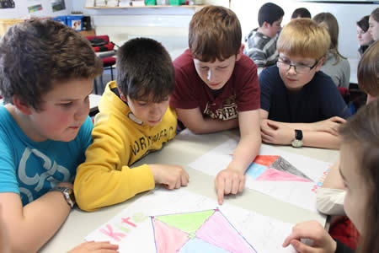
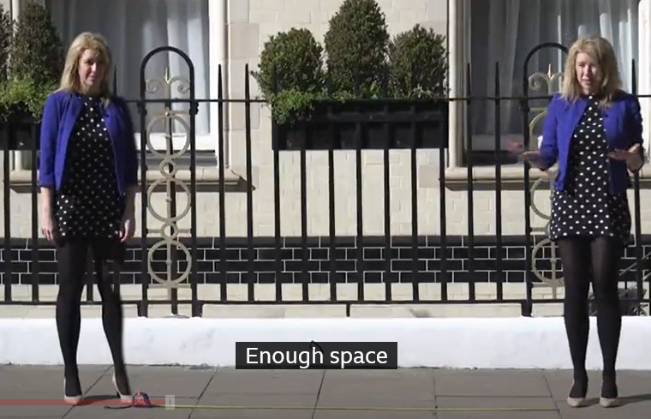
We need to try and practice ‘social distancing’ which means we should try to stay around 2 metres away from anyone else, apart from the people we live with.

Slide 6
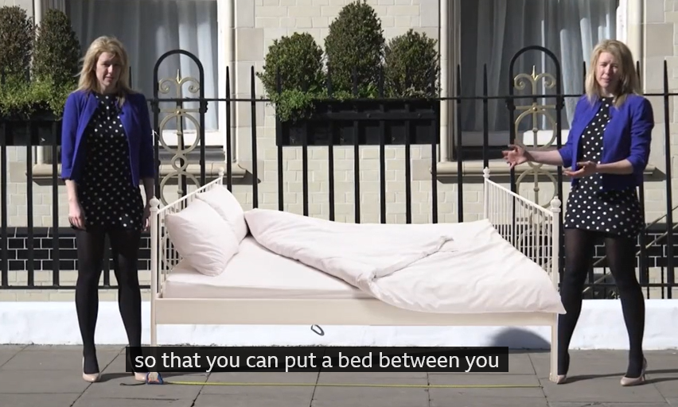
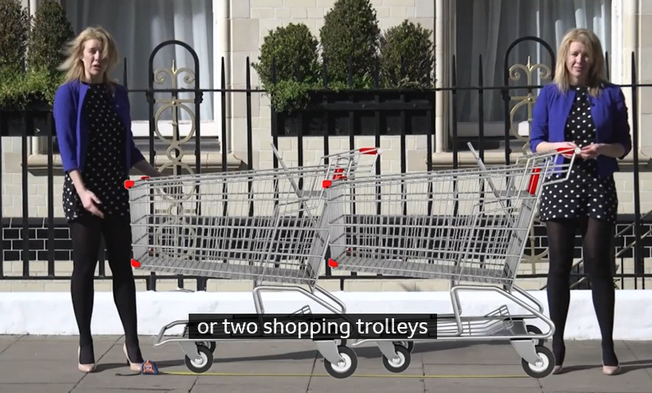
2 metres is 3 big steps
The length of a bed
or
2 shopping trollies

Slide 7
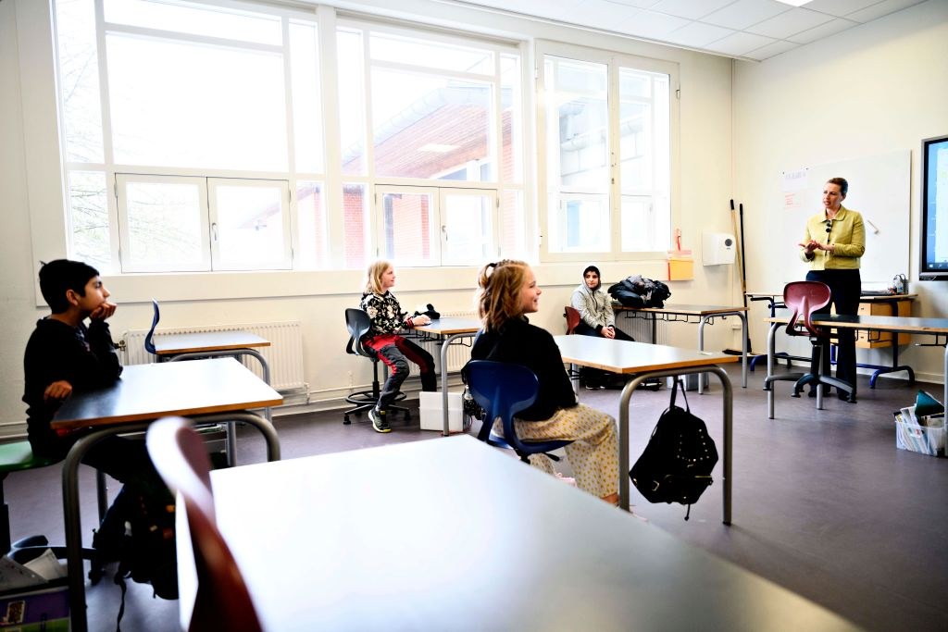
Our classrooms will have less children in so that we can try to stay further apart.
You will have fewer desks and they may be more spread out.
There will be no more than 12 pupils in a classroom.

Slide 8
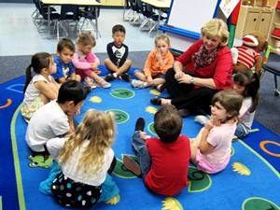
Your class group is your ‘bubble’ – this means you may get closer than 2 metres from them but should try to stay away from people from other bubbles.

Slide 9
You will not be wearing your normal uniform to school. This is so you can wear a clean set of clothes each day.
You will not get changed for PE.

Slide 10
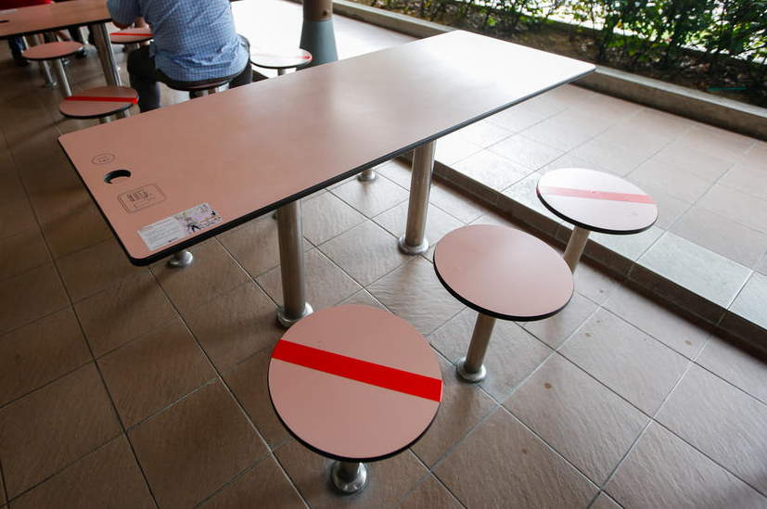
You may have a mark on your desk or chair so you know where to sit and where not to sit.

Slide 11
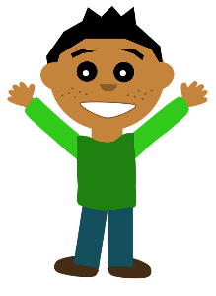
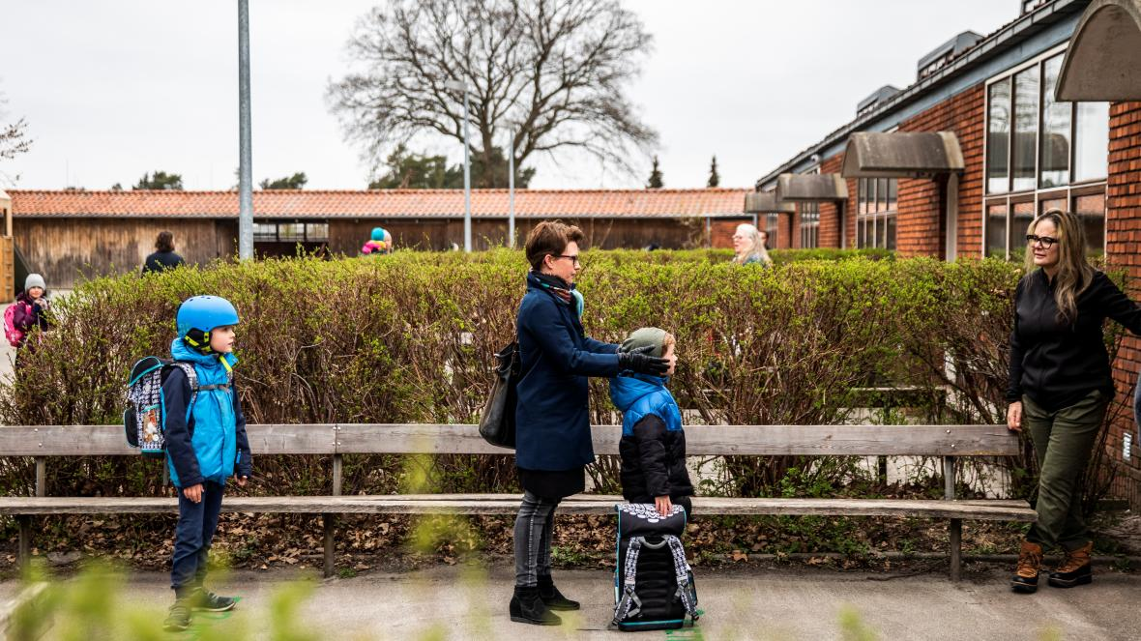
2 metres apart
2 metres apart
We used to all queue up close together. Now, if you are queuing you will need to stand apart.

Slide 12
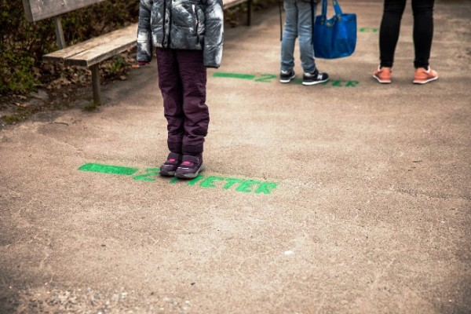
There will be markings on the floor showing you where to stand.

Slide 13
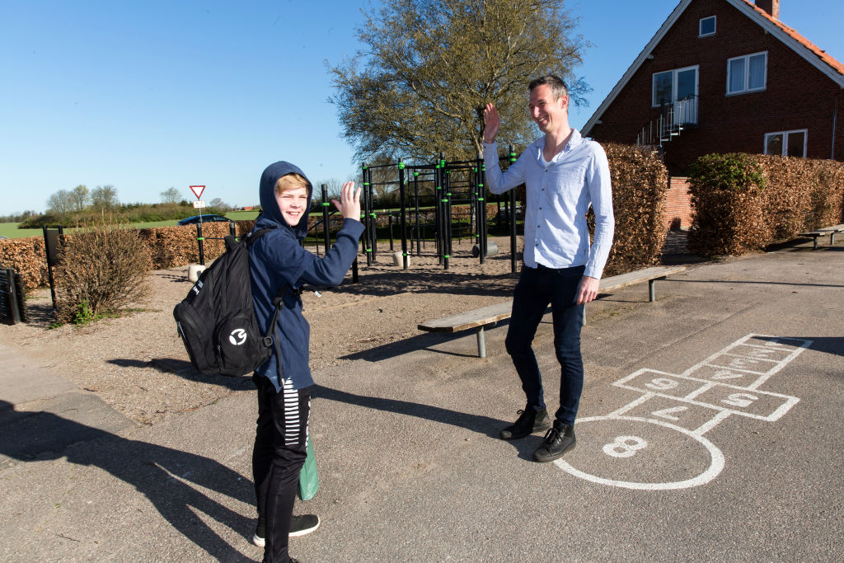
You may be excited to see your teachers or friends. You can greet them by waving from 2 metres away.

Slide 14
Your school may have new routines when you arrive.
You may have to use hand sanitiser as well as washing your hands.

Slide 15
If someone is coming towards you, you may need to move out of their way so they can walk past safely.
It’s OK if someone comes a bit too close – it is a guideline.

Slide 16
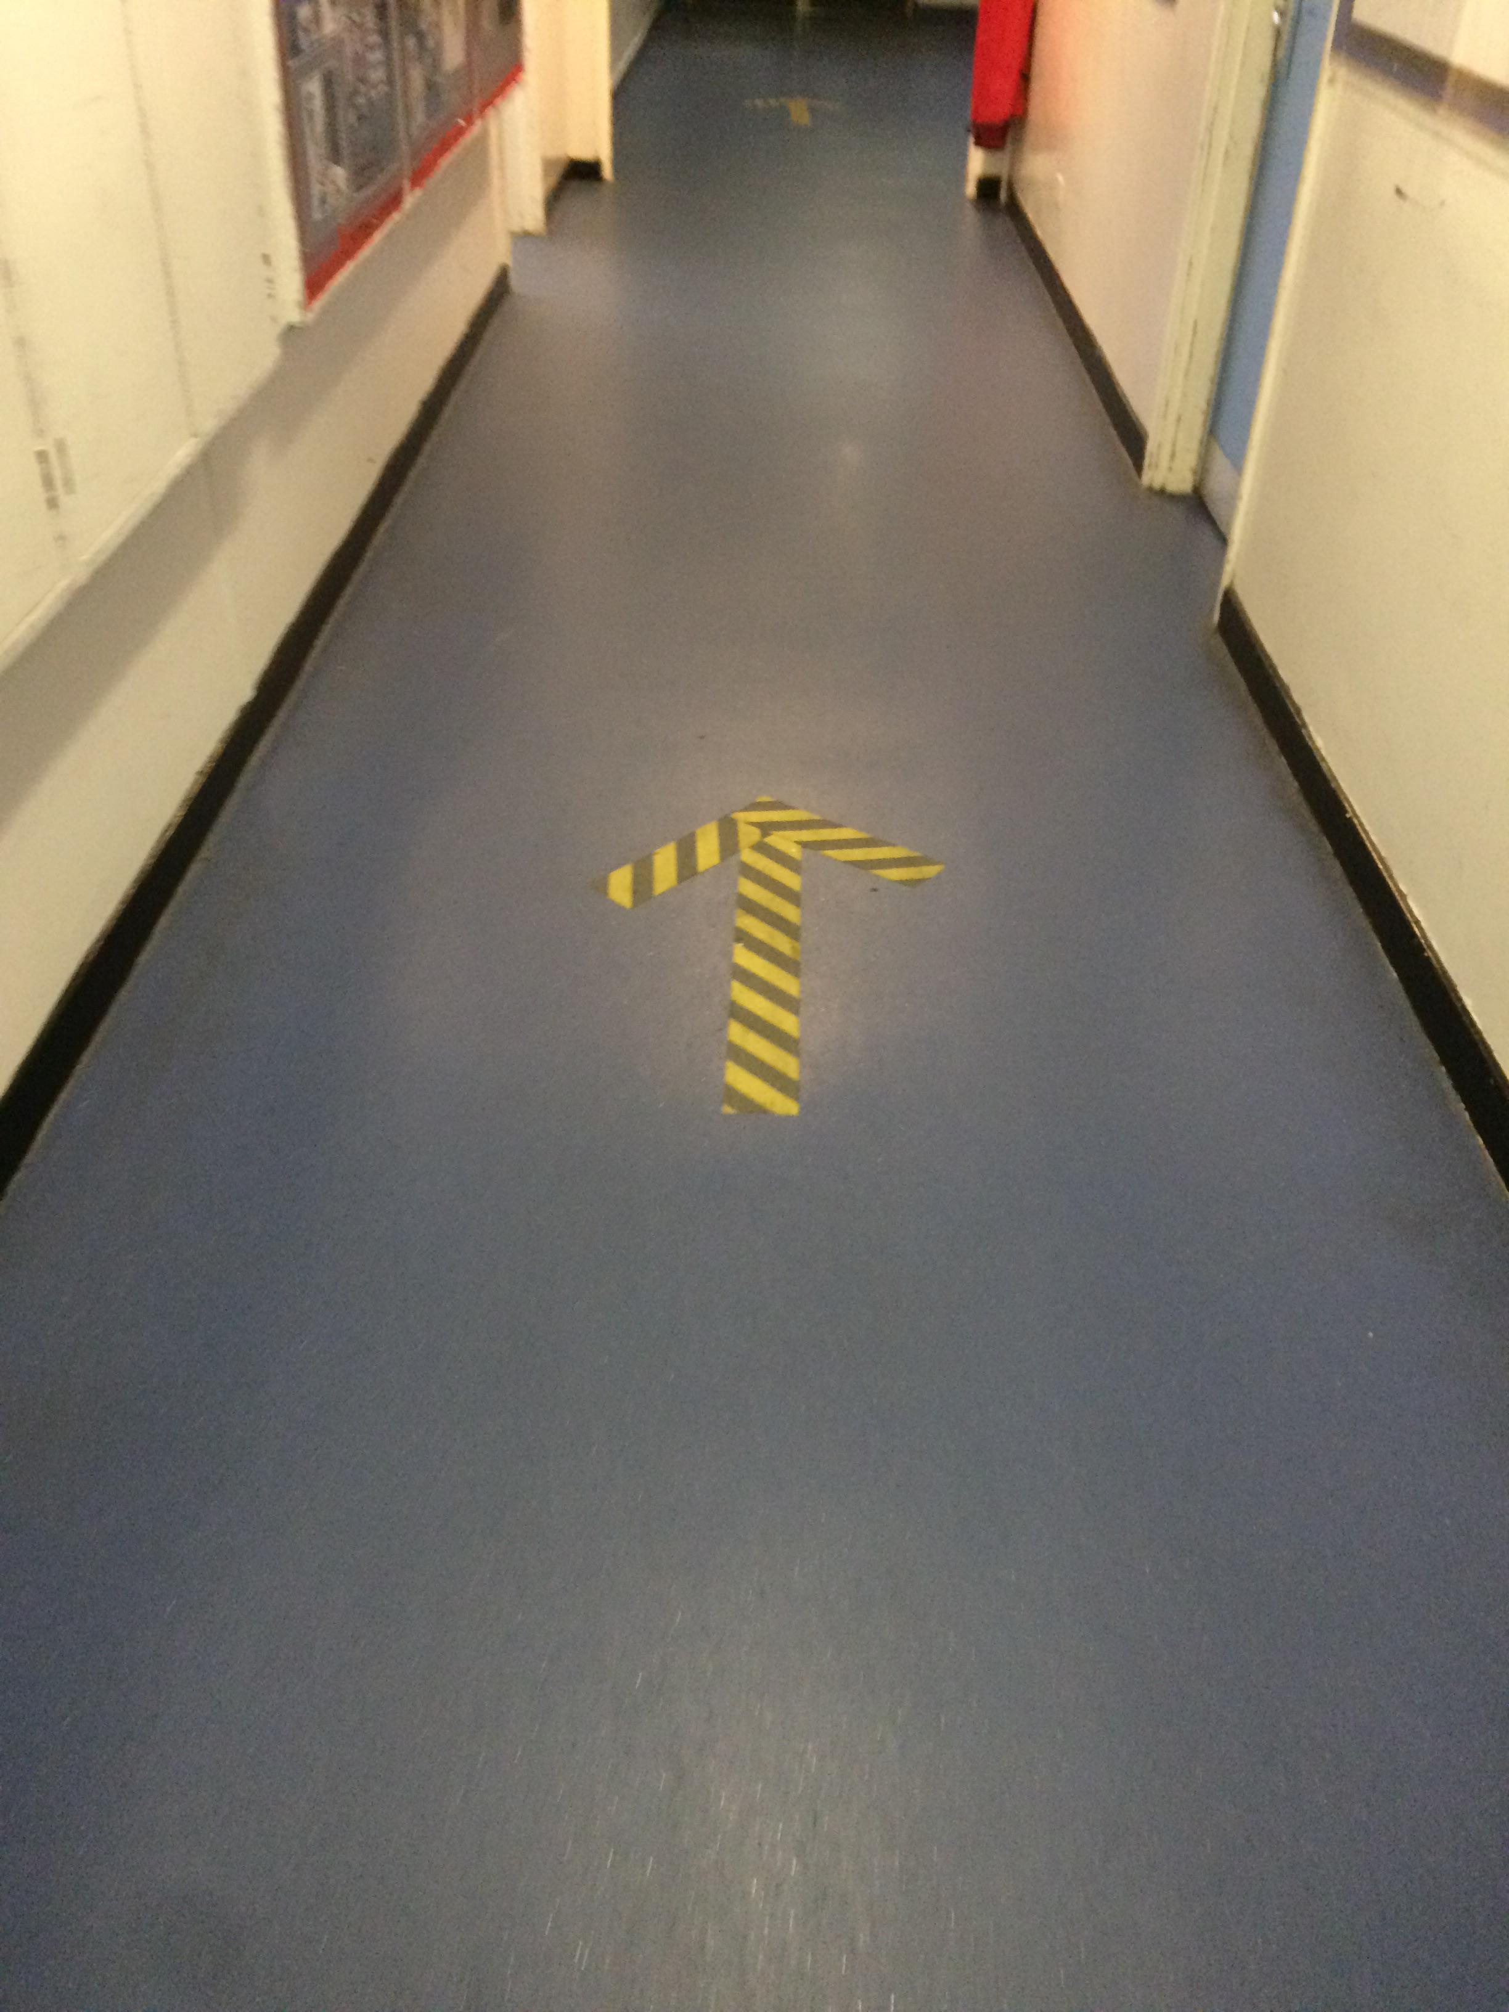
You may have a ‘one way’ system in corridors so you don’t pass anyone else.

Slide 17
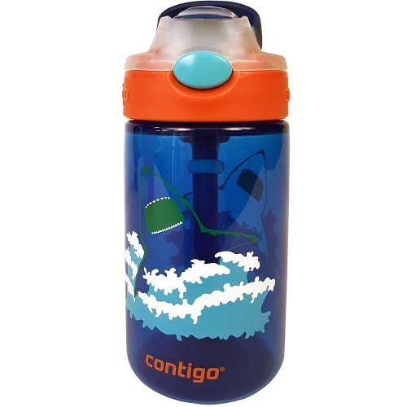
We must try not to touch other people or their things, so this means we need to have our own stationary pack and water bottles.
We cannot share these things at the moment.

Slide 18
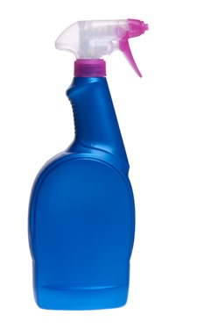
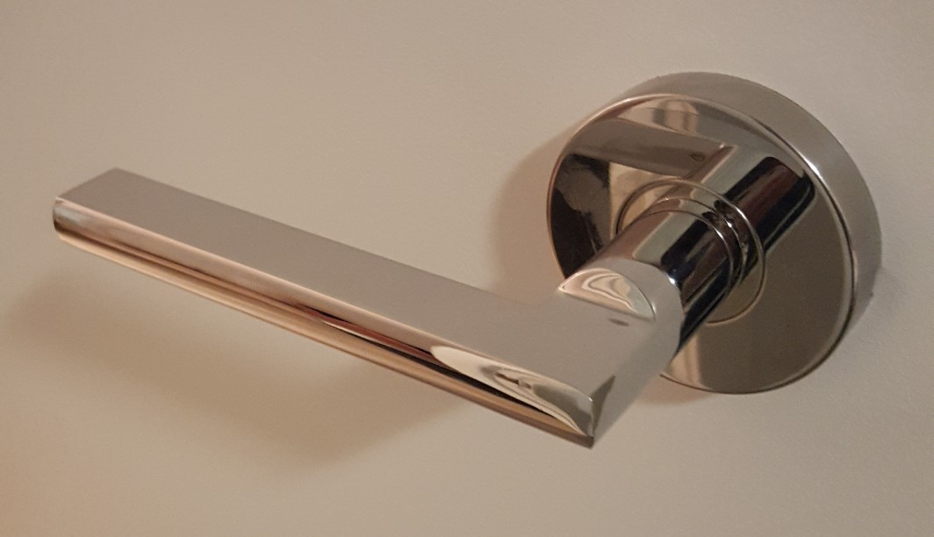
Lots of things will be washed and disinfected during the day and when you go home.
Things like door handles will be cleaned – this helps keep us safe.

Slide 19
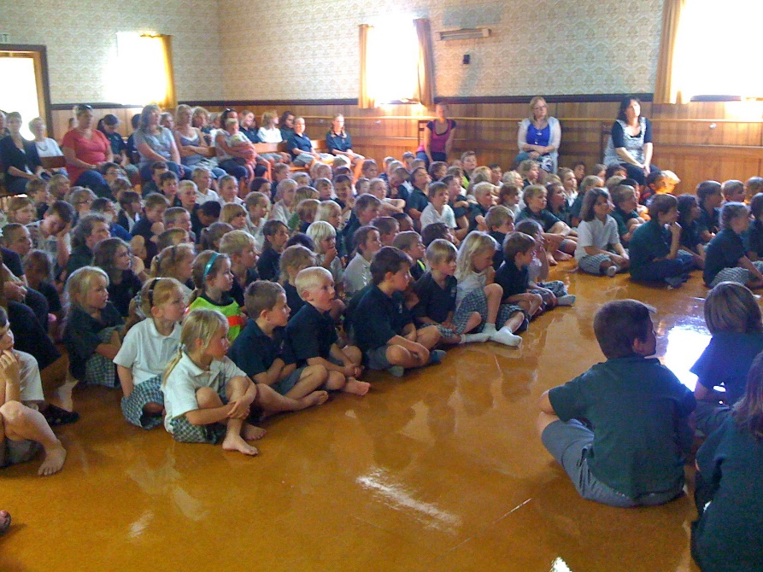
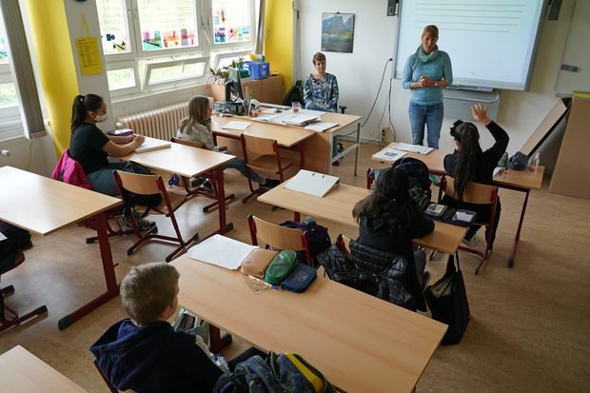
As gatherings are not allowed at the moment, we won’t have assembly/collective worship as a big group in the hall but may meet via video link instead

Slide 20
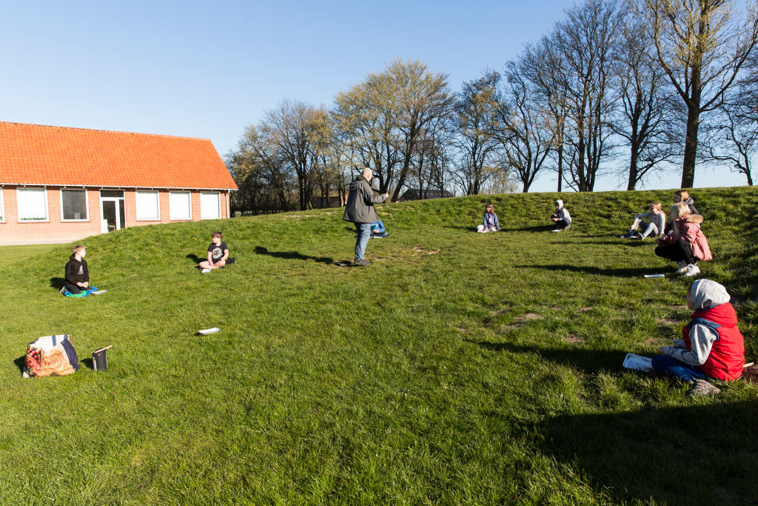
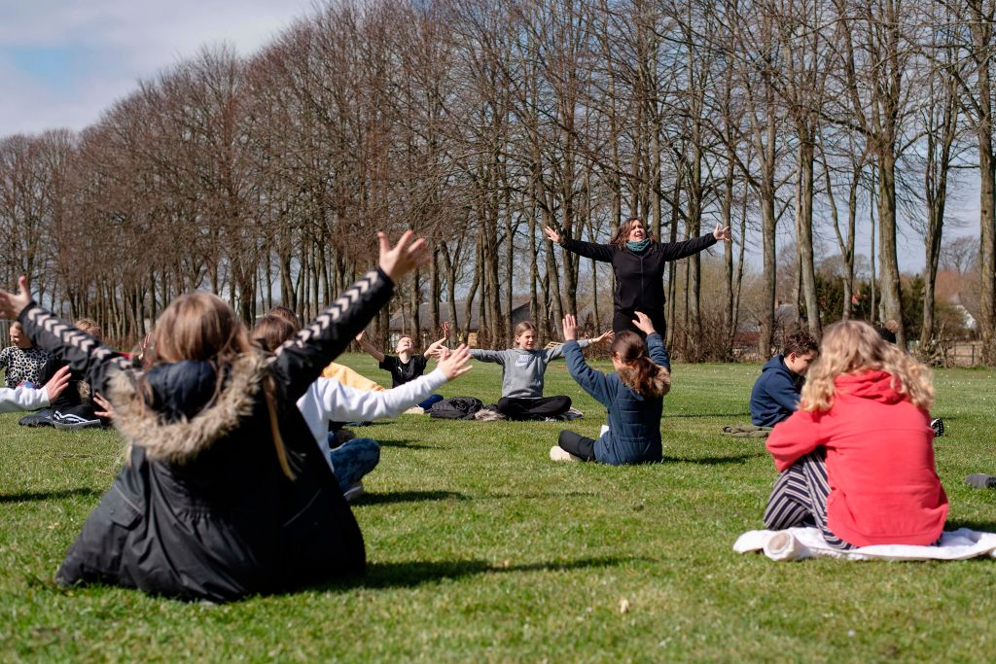
You may have some lessons outside, making sure you all keep apart.

Slide 21
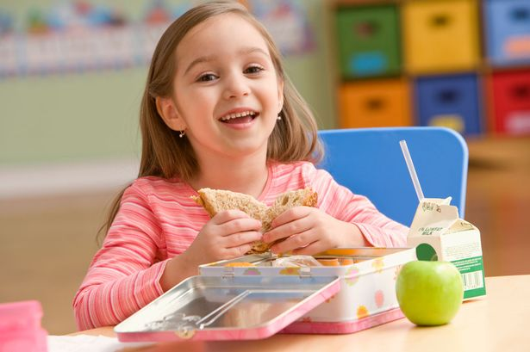
You may eat lunch in your classroom or outside.

Slide 22
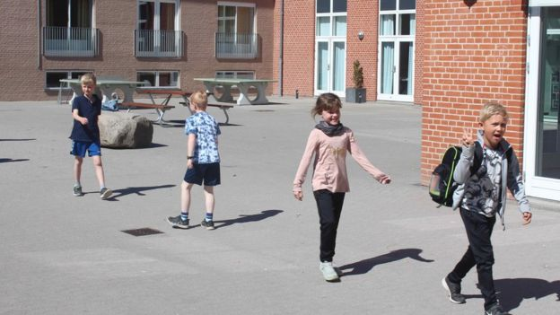
At break and playtimes, you may only be allowed certain equipment. You can play games but try to keep apart from anyone who is not in your ‘bubble’.

Slide 23
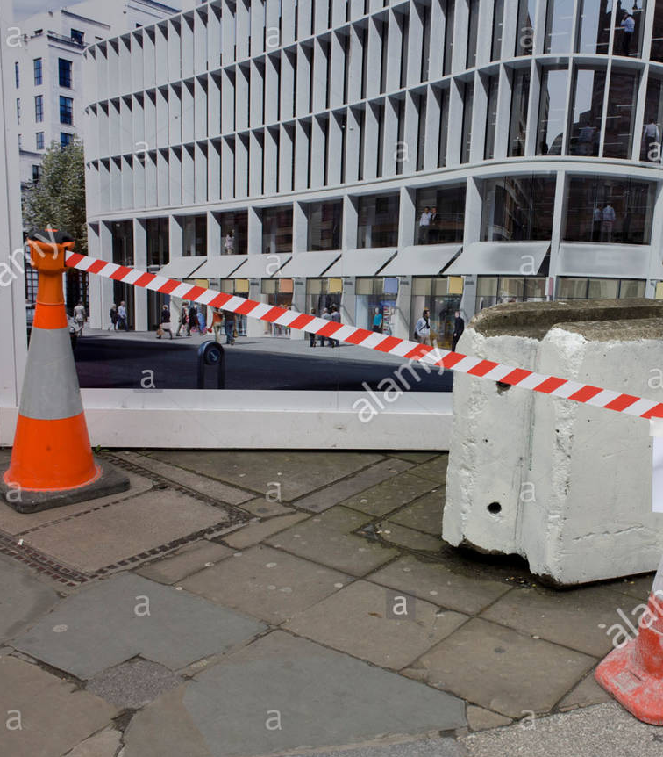
There may be some parts of the school where you are not allowed. These will be marked by tape or signs.

Slide 24
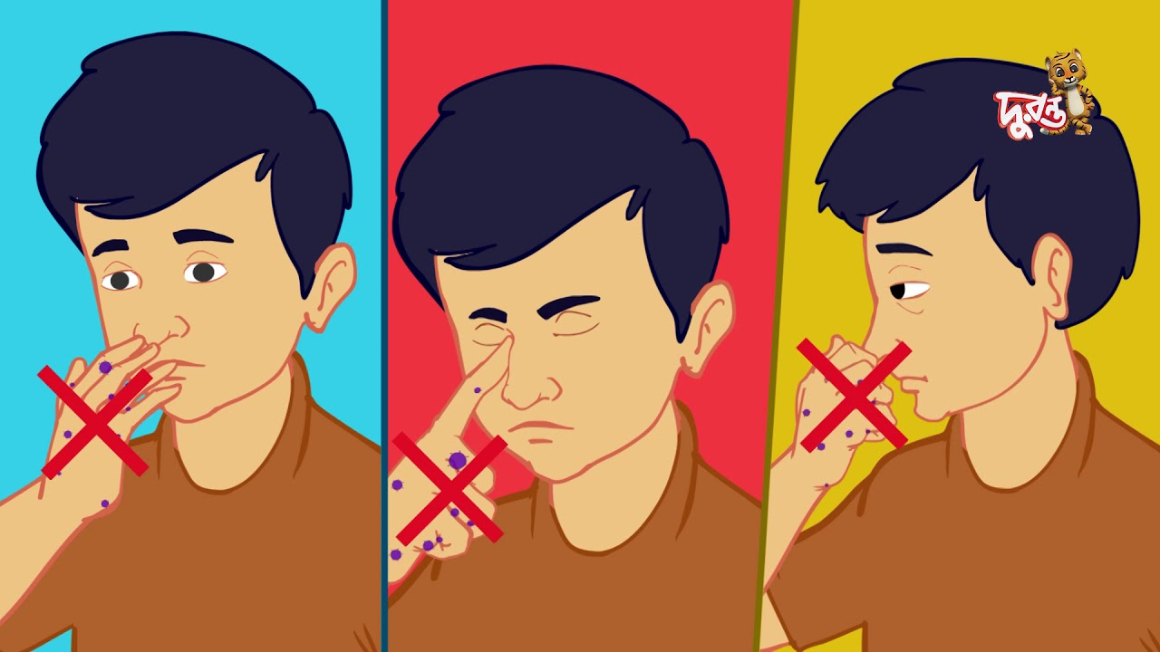
You should try and use tissues when you sneeze or cough and throw it straight in the bin.
Try not to touch your mouth, nose and eyes with your hands

Slide 25
The best way to stay safe is to regularly wash your hands. This should be for at least 20 seconds.

Slide 26
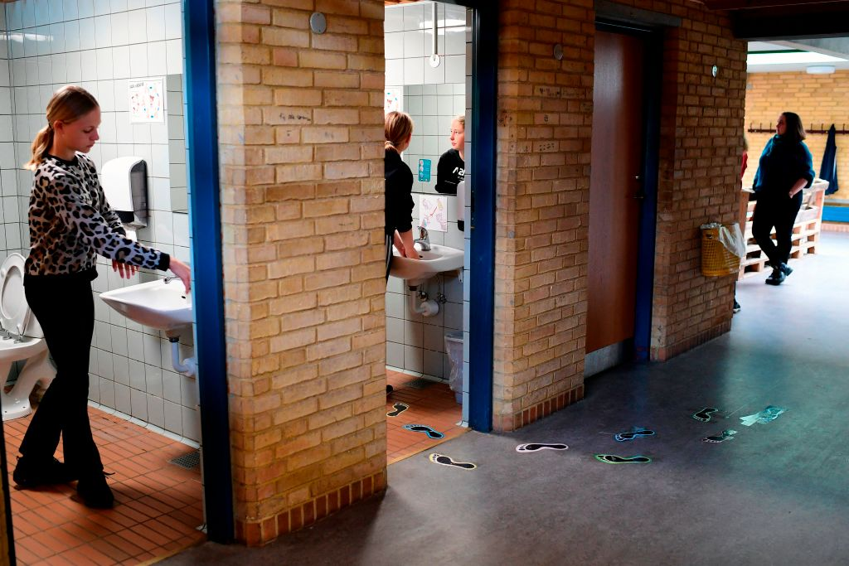
You may have a rota for when you can use the toilet so that all the children in the school can be kept safe.
If someone is already in there, you will have to wait to use the toilet so that we can all keep a safe distance from each other.

Slide 27
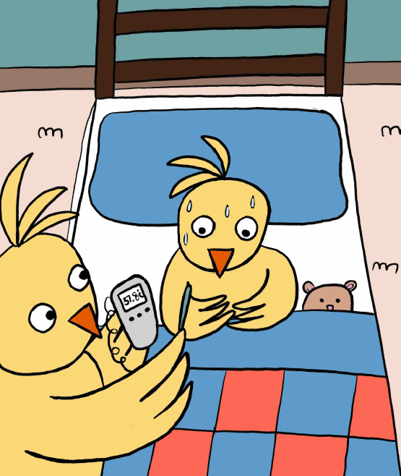
If you are feeling unwell, it is important to tell your teacher or parent as you may need to stay at home until you are better.

Slide 28
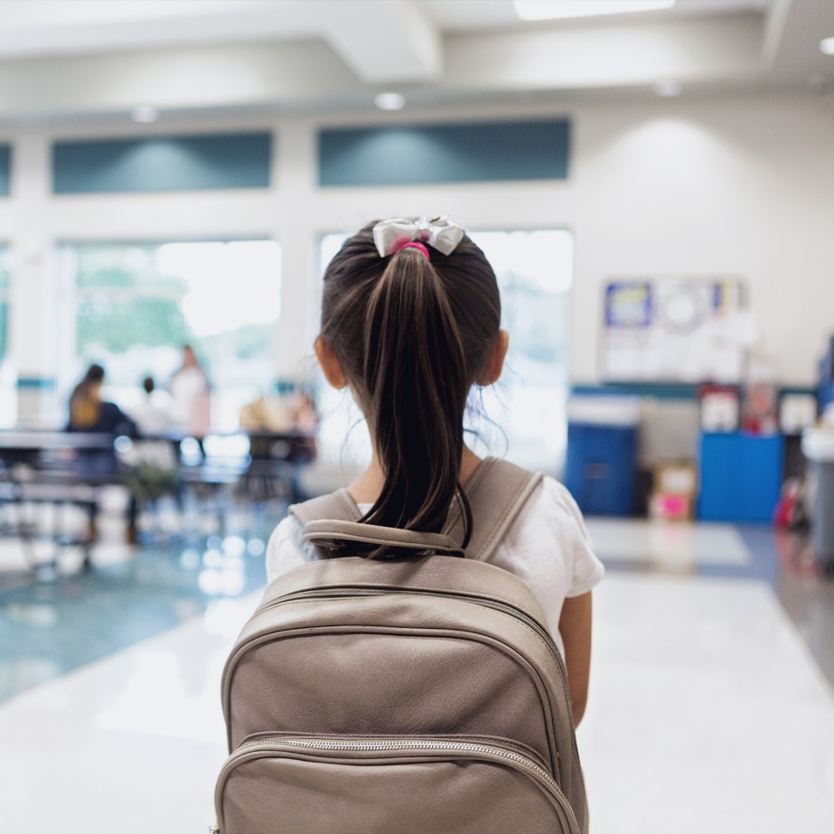
At the end of the day, you may be picked up from a different place at a slightly different time.

Slide 29
Lots of things will be the same in school:
You will see some of the same teachers
You will see some of your classmates
Your building will be in the same place
Most of the school rules will stay the same

Slide 30
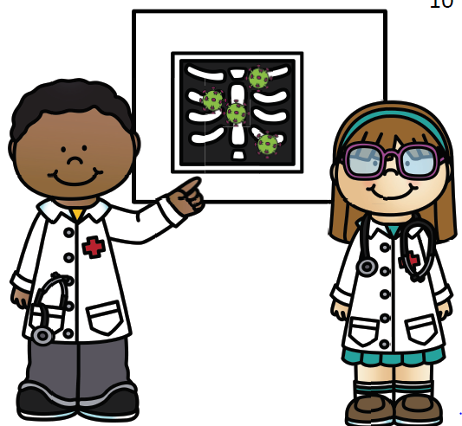
Doctors and researchers are working hard to find ways to make Covid-19 go away.
Once it is gone, we may be able to be closer to people at school again.

Slide 31
We don’t know how long this will take.
So for now we must keep each other safe by:
Remembering your bubble
Keeping 2 metres away as much as possible
Washing your hands regularly

Slide 32
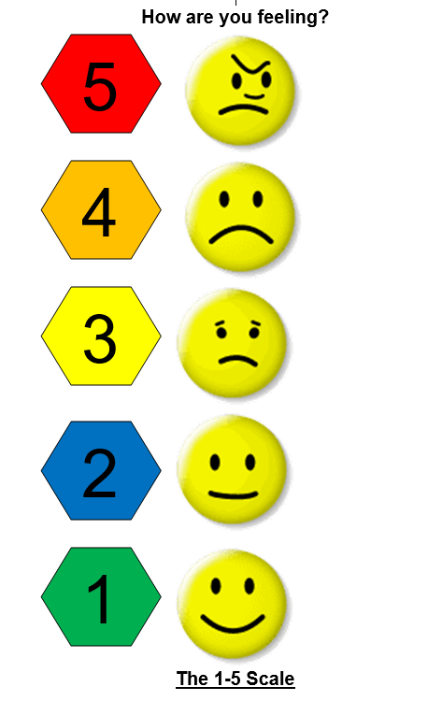
You may have different feelings about returning to school. Some people might feel worried.
You can always talk to your teacher or an adult in school about how you are feeling.

Slide 33
We are looking forward to welcoming you back soon.

